Slide 1

Industry / IBM Project Project Presentation on “Intelligent Loan Management System”
By
Group ID: 15
Team Members Name & Enrollment No:
Rahul Prajapati (18162171024)
Om Patel (18162121013)
Kevin Pandya (18082271004)
Institute of Computer Technology, Ganpat University
:

Slide 2
Table of Contents
Introduction
Objectives
Related Background
Expected Outcome
Tools & Technology
Methodology (Modules)
Design / Diagrams & TimeLine Charts with Milestones
Flowchart & Algorithms
Implementation Details
Conclusion
References
2/12/2022
2

Slide 3
Introduction
Clients can apply for loan online through the Intelligent Loan Management System project.
Clients will have to submit their documents online on the platform.
System will help loan approvers in Loan Approving Process using AI
Easy access to all the details of loans for users
Secure Payments gateways with Complete auditing
2/12/2022
3

Slide 4
Objectives
Platform would be User friendly with Separate Access Rights allocation for different Stakeholders
Centralized Solution
Intelligent System which will help all the stakeholders which will make process fast and efficient
Cloud based deployment
Using secure third-party integrations
Web and Mobile Compatibility
Secure Operations
4
Notes:
Edit if you feel like…
13

Slide 5
Outcome
A secure and powerful Loan Management System where customers will be able to manage their loans easily along with a secure transactions in between the different phases or modules of the application.
A system where Loan Approvals will be fast with the use of AI.
Decision making for loan approval by the Admin is made easy by this application due to the self analytics of the loan applicant by the app.
Implementation of Smart Functionalities
5
Notes:
Need to be Edited
13

Slide 6
Background
Online Loan Management System is a very efficient project that can handle all the loan approval and management related task easily.
Loan management systems help automate the entire loan lifecycle. Depending on requirements, these programs can assist in part or whole.
The Web App can help with processing customer information, create new loans, and more. They can also provide lenders with accurate statements and reports. Moreover, they can manage interest rates and provide the tools for collection automation.
6
Notes:
13

Slide 7
Tools And Technologies
Python Language
DJango Framework (For Web App)
MySQL for Database Connectivity
Visual Studio IDE
AWS elasticbeanstalk
AWS RDS
AWS codepipeline
http://ilmsg15-env.eba-njttbzvs.us-east-1.elasticbeanstalk.com/
7
Notes:
Needed to be edited (Localhost Domain)
13

Slide 8
Methodology
User will calculate his credit score and add details of any active loans
Based on user’s credit score and
Applicant will upload his documents and fill up the necessary details in the loan application and apply for loan system will suggest him suitable loans
System will validate uploaded documents and details and if it finds anything wrong with the application then it will reject the application
After the verification the application will be forwarded to the Loan Approver
8
Notes:
13

Slide 9
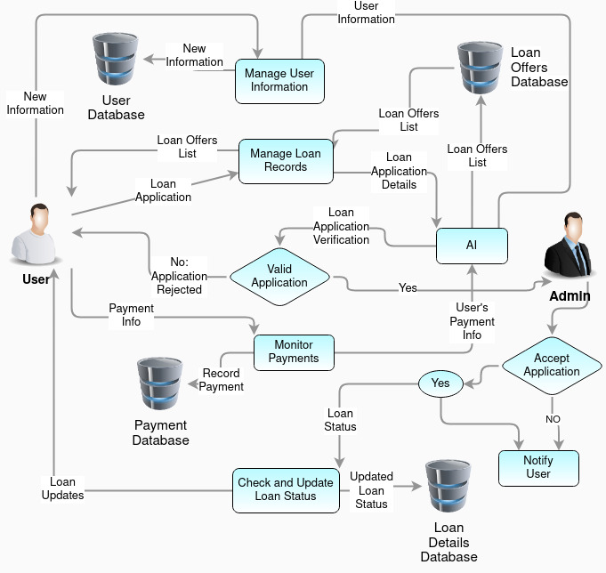
Diagram
8
Notes:
13

Slide 10
Implementation Details
Rahul Prajapati:
Login Failure Limit, Client can ask questions to admins
Admin can see queries asked by users and answer them
Client Can Apply for loans and check the status of applied loans
Kevin Pandya:
Client Dashboard, Customer List
Contact Us Page, Landing Page (Admin’s Dashboard) for Admin user,
CRUD Operations on Registered Users
Implement CICD Pipeline on Live Project
Upload the project on AWS and make it Live using ElasticBeanStalk
OM Patel:
Implementation of EMI Calculator.
Create New loan schemes, Approve/Reject Loan applications, Create Loan Categories
Client Can Apply for loans and check the status of applied loans
10
Notes:
This page needs to be added…. For Reference look see the PDF Report
<number>

Slide 11
Conclusion
This product gives the an easy and user friendly User Interface where he will get intelligent suggestions for his loan management and loan applications.
This product makes the loan sanctioning fast and efficient by adding AI which will verify application details and documents and if it finds something wrong it will reject the application by itself.
All the transactions done will be secure.
10
Notes:
<number>

Slide 12
References
https://www.leadsquared.com/loan-management-system-features-benefits/
https://lendfoundry.com/faq/why-should-you-use-a-cloud-based-loan-management-software/
https://lendfoundry.com/blog/10-features-of-the-perfect-loan-management-software/
https://www.arttha.com/choosing-a-loan-management-system-for-your-bank-key-features-to-consider-for-an-optimized-experience/
https://www.leadsquared.com/loan-management-system-features-benefits/
11
Notes:
<number>

Slide 13
Thank You !!
2/12/2022
13

